Slide 1
Using GitHub Desktop

Slide 2
Create a Github Account
Join GitHub · GitHub
Use whatever Email you want to log in, you can always link your school email later
Use a professional username, this will be seen by future employeers.

Slide 3
Accept Lab Assignment
Find labs on the Wiki here
Find the link for the lab section you are in and click on it
When prompted sign in to your github account
After redirect click accept this assignment
Wait a minute and then refresh the page

Slide 4
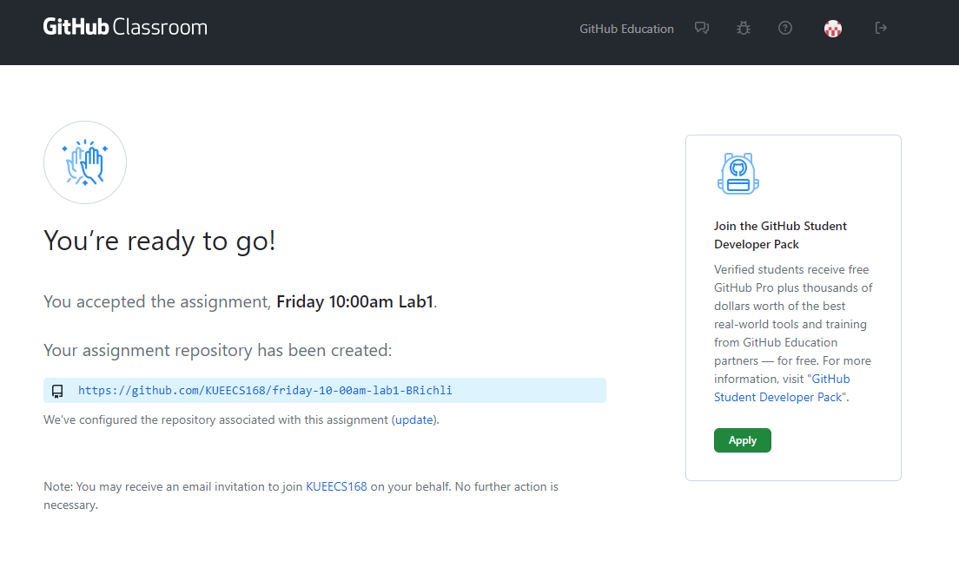
After Refresh Click the Link

Slide 5
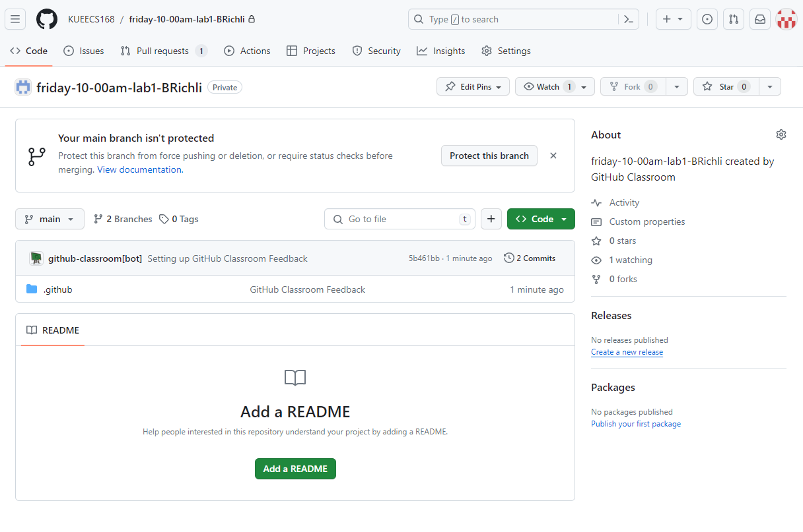
This will be your github repository for this assignment

Slide 6
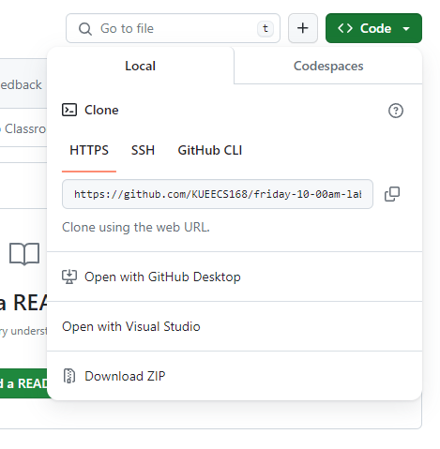
Click Code and in the Dropdown Click Open with Github Desktop

Slide 7
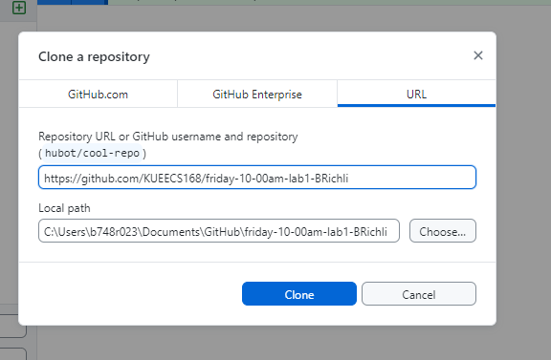
In Desktop it will open this window
Do not alter the hyperlink!
You can change the folder path to a folder you would like to have this lab in. Ex: School\168\labs\lab1

Slide 8
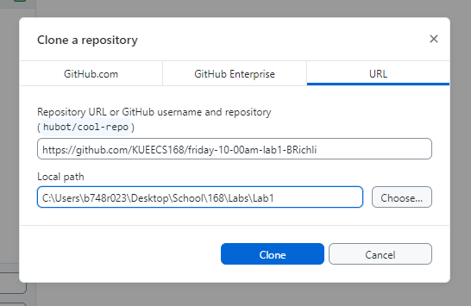
Make Sure that the parent folder exists though!
Ex: I made sure to create the folder Desktop\School\168\Labs before this step. GitHub created the Lab1 folder for me after I clicked clone.

Slide 9
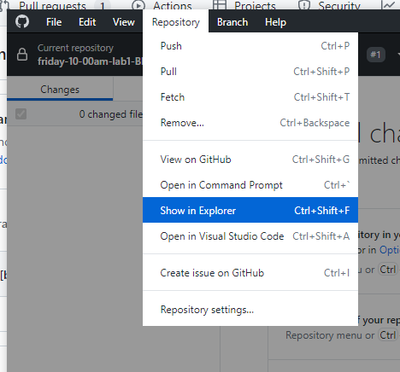
Open the folder that your repository cloned into. The menu options may look a little different for Mac or Linux Users. You can also use your file system to navigate to it.

Slide 10
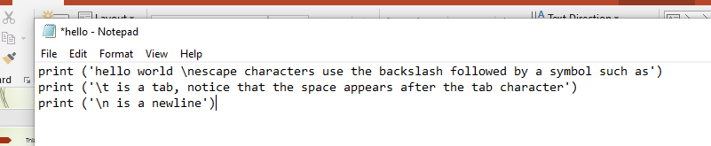
Open a Text Editor, or IDE, Create your first Script
I personally prefer Sublime Text (free) for windows and Mac
Lab Computers use nano
In this demonstration I will be using notepad

Slide 11

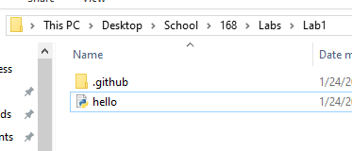
Save your file to the folder your github repo is connected to, be sure to save with the correct format
Because I am using notepad I save it as a python file by selecting All Files as type and making the name I save it as end in .py This may differ slightly depending on your OS and your text editor.

Slide 12
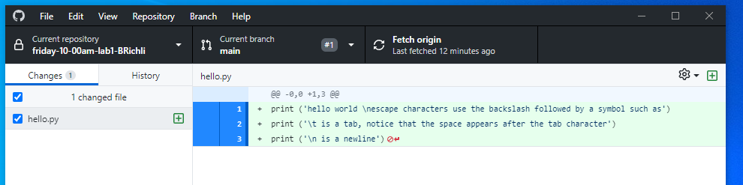
The file I have added now shows up in github desktop with all of the changes shown.

Slide 13
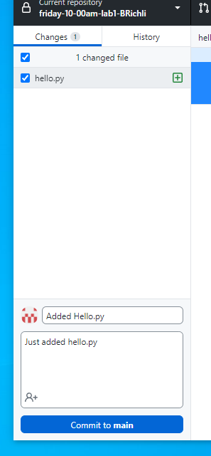
In the bottom left pane add a short comment describing what the change is and click commit to main.

Slide 14
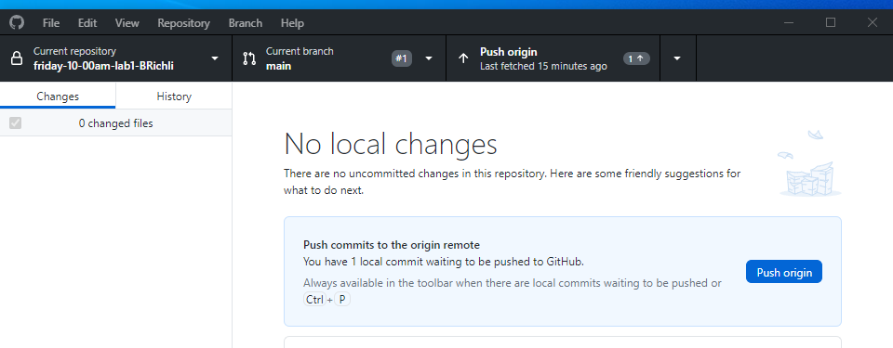
Finally Click “Push Origin” This sends the changes to your online repository

Slide 15
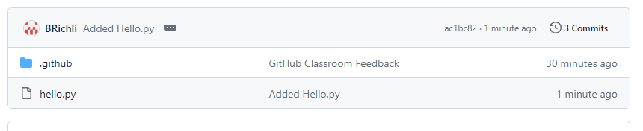
Back on your github account online, refresh the page and check that your changes posted
See, my new file has posted. I can click it to see what the file looks like.

Slide 16
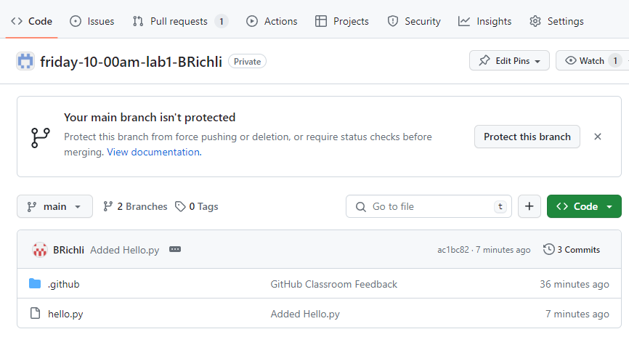
Getting Feedback and Your Grade!!
Click Pull requests

Slide 17
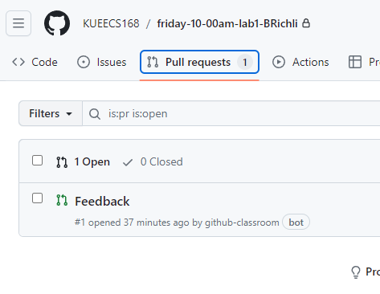
Click Feedback

Slide 18
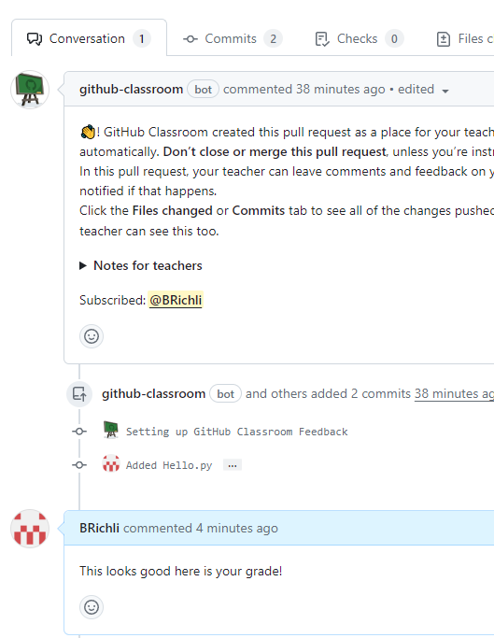
This will be a thread of feedback from me. You are free to message me about feedback too. Email is probably faster though.
This is my username, please be sure to check feedback regularly. Especially if I need you to correct issues before I commit your final grade.

Slide 19
And that is the process
Make sure every change you make to your assignment is done in the folder you created through github
Make sure you comment, commit, and push every change.
Make sure you check for my feedback.
GitHub has methods to roll back your commits to previous versions if you make a mistake. GitHub is a very important part of any programmers process. Please create your own repositories and play practice committing and pulling your changes.

